Slide 1
DATA ANALYTICS PROGRAM
INSTAGRAM USER ANALYTICS
~ ARYAN AUDITTO

Slide 2
The project aims to analyze the Instagram database to assist the marketing team and investors in making data-driven decisions. The analysis includes finding the oldest and inactive users, identifying the winner of a contest, suggesting commonly used hashtags, determining the best day to launch ad campaign, and assessing user engagement and presence of bots on platform.
PROJECT DESCRIPTION :-
APPROACH :-
To perform the analysis, I uses SQL queries on the provided database. I first explored the database schema to understand the relationships between the tables and columns. Then, I used SQL to find out required data for each task and provided insights.
TECH-STACK USED :-
I used DB Fiddle MY SQL version 8.0 to run SQL queries on the provided database.

Slide 3
Through this project, I gained insights into the Instagram user base. I discovered the top hashtags used on the platform, the most active day for user registration, and the average number of posts per user. Additionally, I identified fake accounts on the platform based on their unusual liking patterns.
INSIGHTS :-
The analysis helped in order to determine reward the most loyal users, remind inactive users to post, identify the winner of a contest, suggest commonly used hashtags, and determine the best day to launch ad campaign. Furthermore, the analysis provided investors with insights into user engagement and bots on platform.
RESULT :-

Slide 4
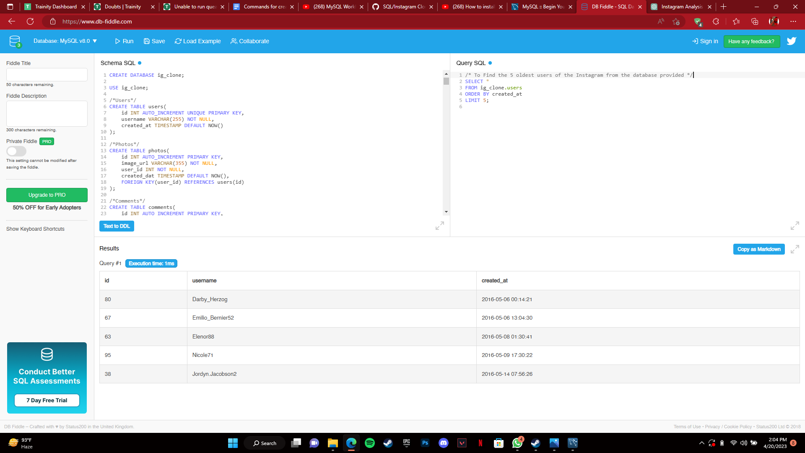
A) MARKETING :-
1) Rewarding Most Loyal Users :-

Slide 5
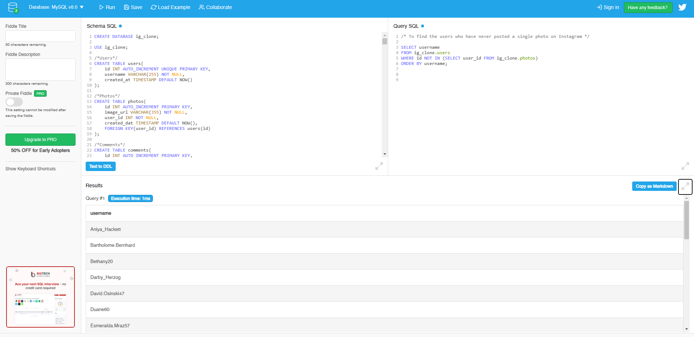
A) MARKETING :-
2) Remind inactive Users to start posting:-

Slide 6
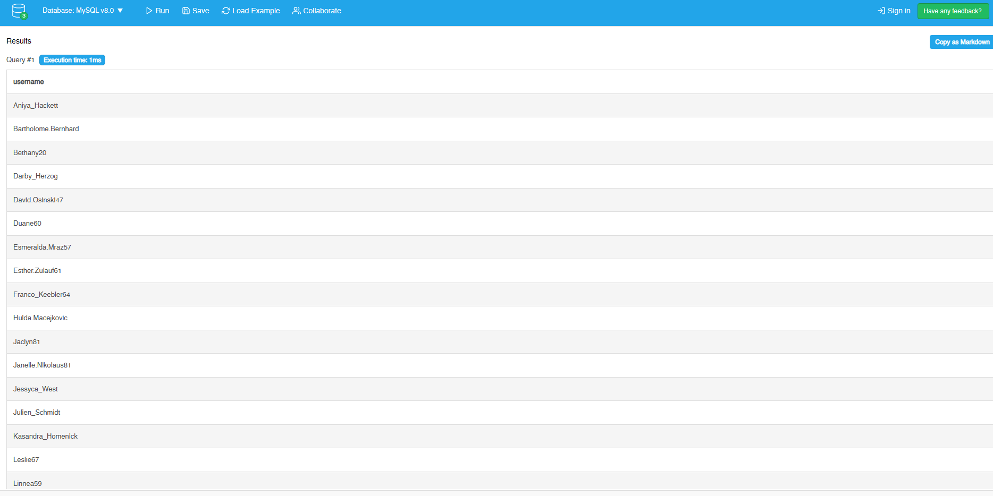

Slide 7
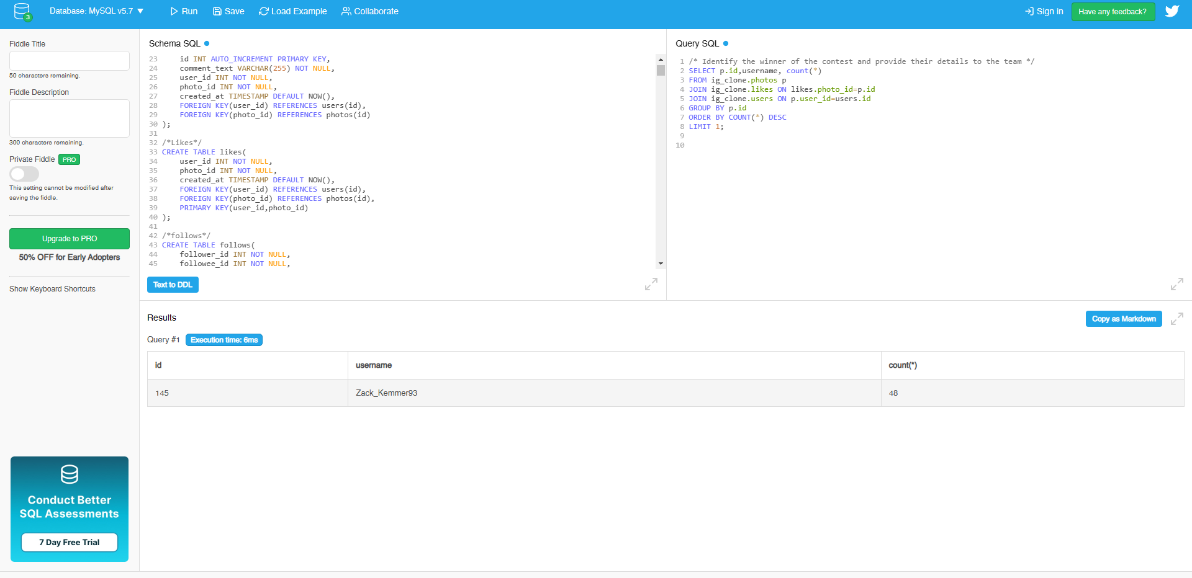
A) MARKETING :-
3) Declaring Contest Winner :-

Slide 8
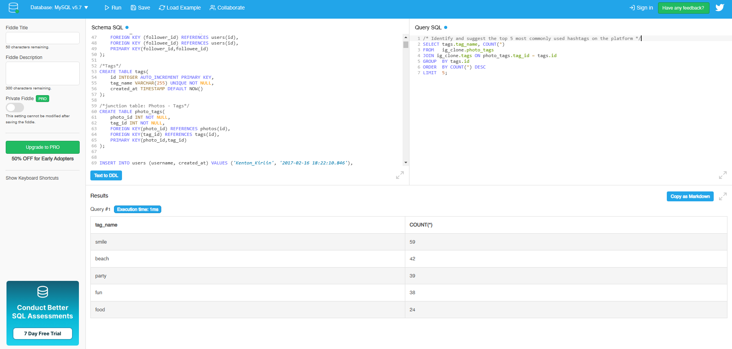
A) MARKETING :-
4) Hashtag Researching :-

Slide 9

A) MARKETING :-
5) Launch AD Campaign :-

Slide 10

B) INVESTOR METRICS :-
1) User Engagement :- To provide how many times does average user posts on instagram

Slide 11

B) INVESTOR METRICS :-
1) User Engagement :- To provide the total number of photos on Instagram/Total number of users

Slide 12

B) INVESTOR METRICS :-
2) Bots & Fake Accounts :-

Slide 13
